Slide 1
Multimedia final project
Content based multimedia retrieval system
Team 40

Slide 2
Agenda
Project objectives
Project details
Demo time

Slide 3
Team
Image retrieval:
Mai Abdel Gawad Ahmed
Yara Ayman Yassien
Hadeer Essam Mohamed
Mohamed Sherif Awad
Video retrieval:
Alaa Mohamed Salah
Youmna Hassan
Desktop application:
Amr Mostafa
Marwan Mohamed
Database design :
Amr Mostafa

Slide 4


Introduction
With the rapid increase in the size of digital multimedia databases , the search for the relevant information has become more challenging. To get accurate retrieval results is still an unsolved problem and an active research area.
We’ll discuss one of the purposed techniques to solve this problem .

Slide 5
Project objectives

Slide 6
The project objective is to create
- CBIR :content based retrieval system
-CBVR: video based retrieval system
Both systems will be used through a desktop application

Slide 7
Project details

Slide 8


The project is divided into :
-Image
-Video
-Database
-Desktop App

Slide 9

1-image algorithms :
A-Histogram
B-Color-based
C-Texture-based
D-Shape-based

Slide 10
2-video algorithm :
match videos by matching a sequence of frames.
using the root mean square error method for comparing one video frame to another

Slide 11
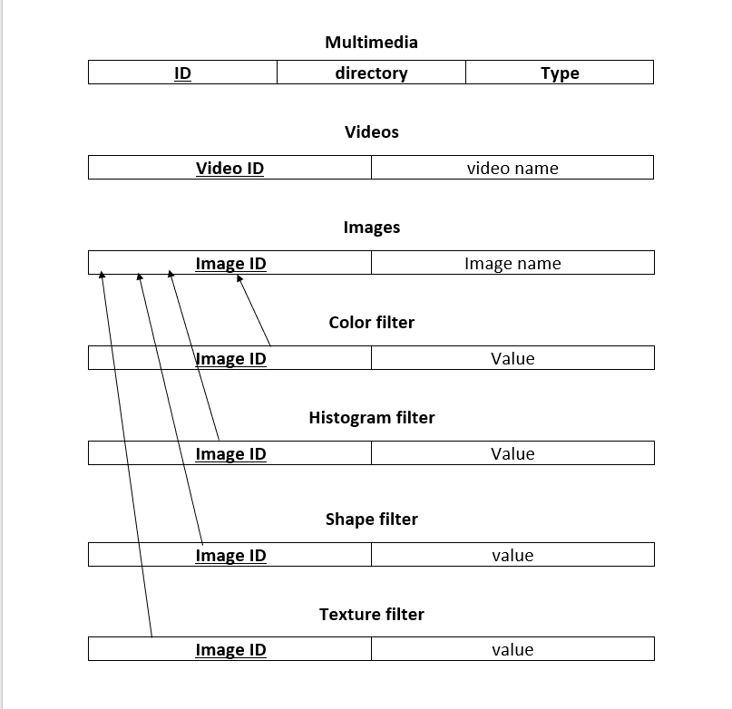
3-Database:

Slide 12
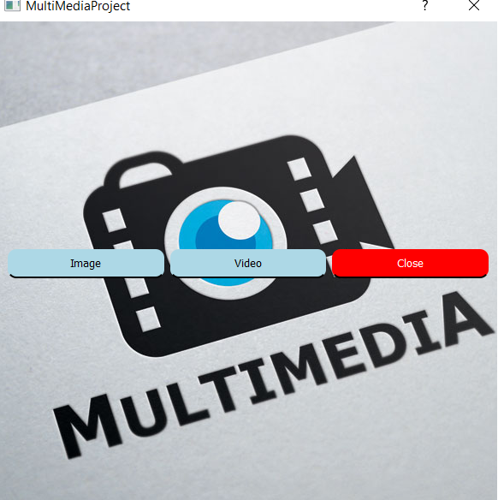
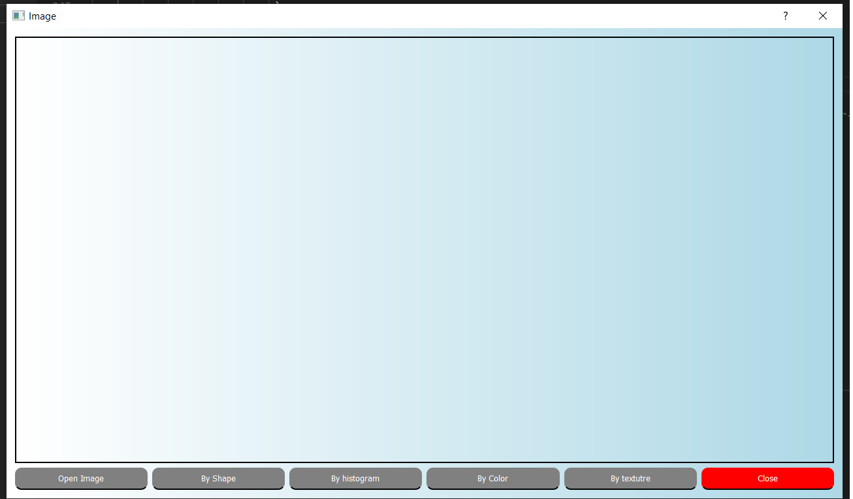
4-Desktop App: using pyqt5
Main screen
Image retrieval screen

Slide 13
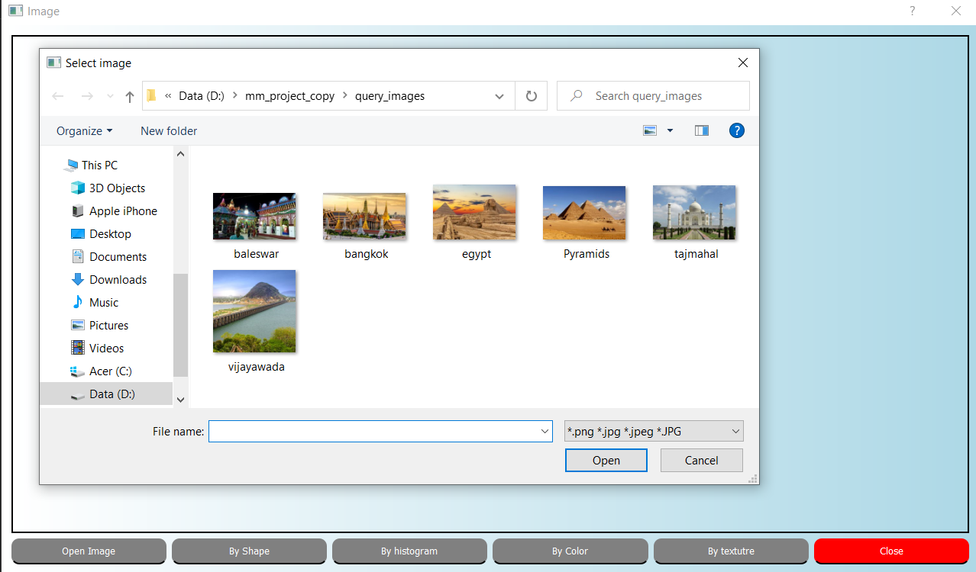
Choosing the image and then choose the filter required

Slide 14
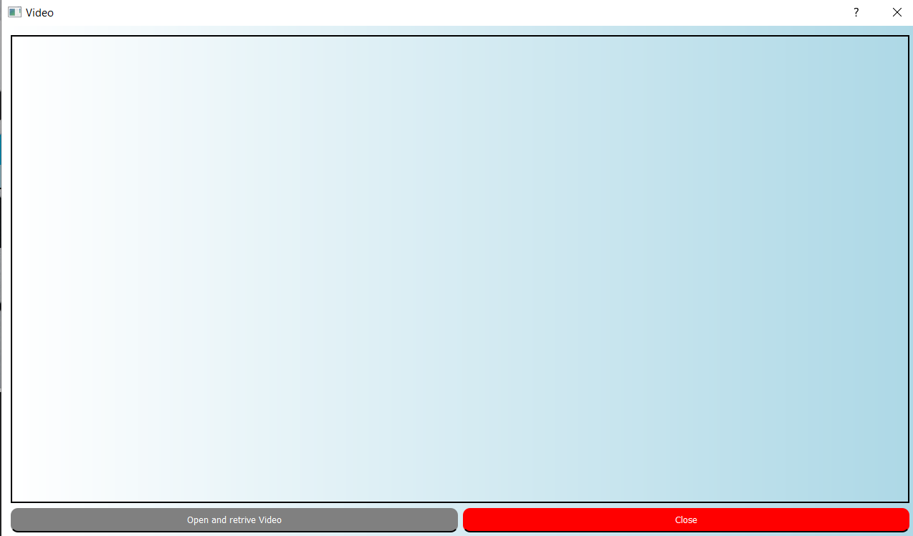
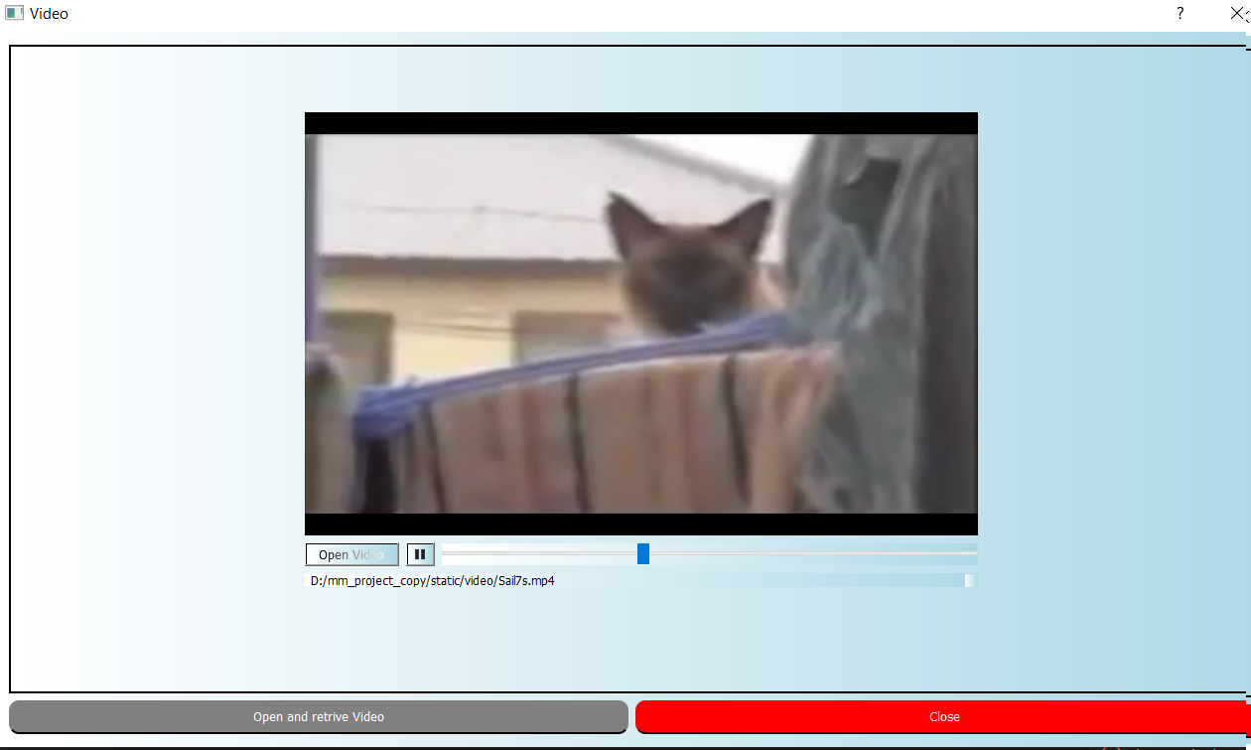
Choosing the video retrieval option and then pick the video

Slide 15
Demo

Slide 16
Thank you

